Slide 6
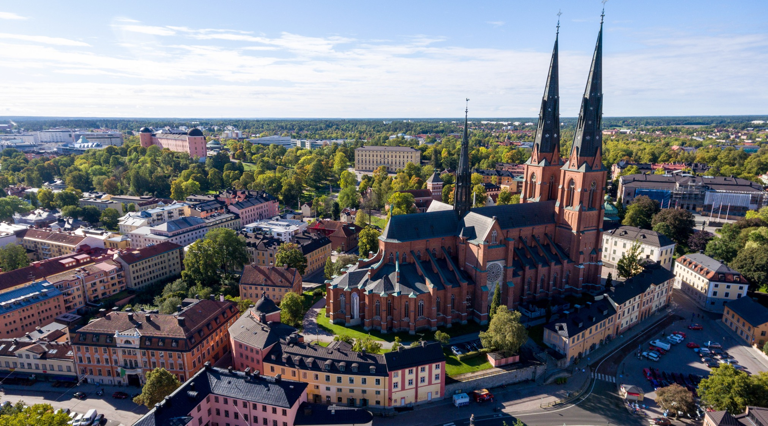

Slide 7
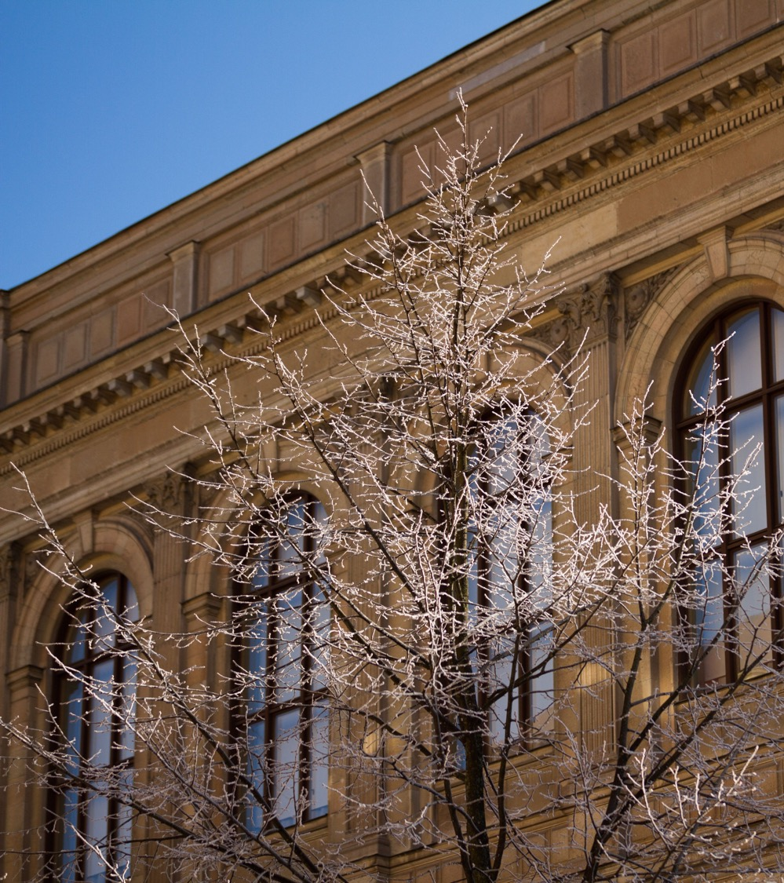
Uppsala University
Always moving forward – since 1477.
A meeting place for knowledge, culture and critical dialogue.
Notes:
This is Uppsala University. The first university in Sweden and the whole Nordic region, founded as early as 1477.
Today, we are a comprehensive research university with clear objectives: to conduct research and provide education of the highest quality, and to work to disseminate knowledge throughout society.

Slide 8

Our mission
To gain and share knowledge for the benefit of humankind and for a better world.
Notes:
Our mission – to gain and share knowledge for the benefit of humankind and for a better world.

Slide 9
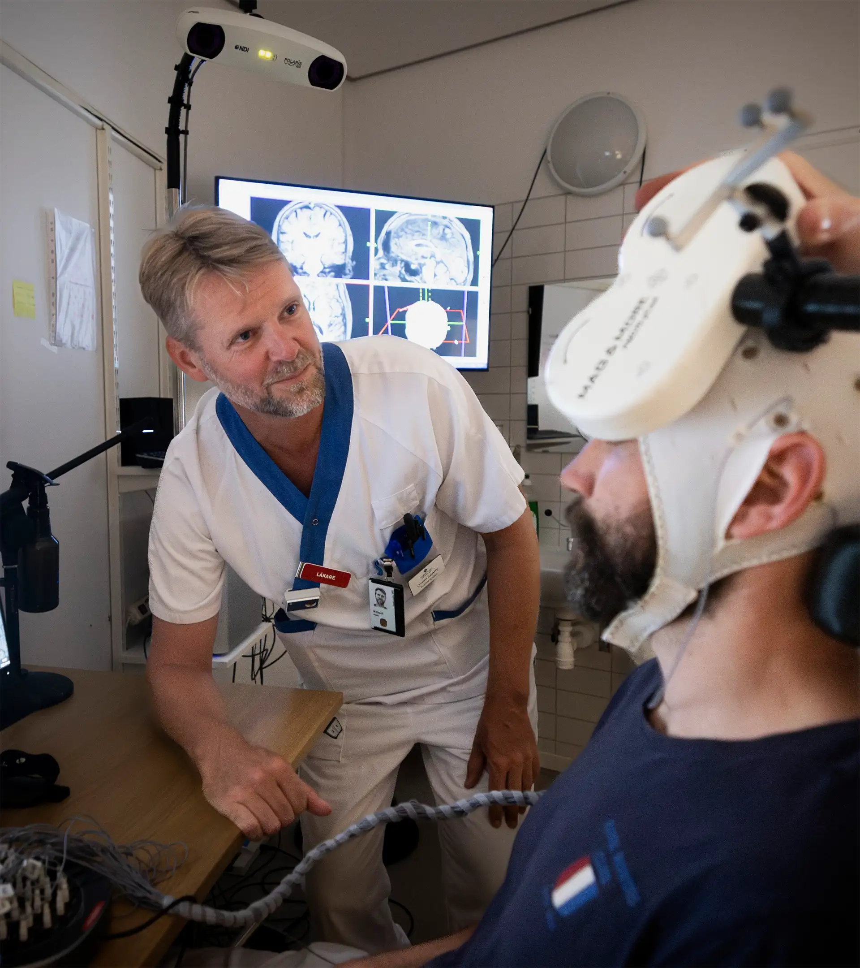
Our goal
Research and education of the highest quality and relevance.
Notes:
Uppsala University is founded on the belief that investment in education and research contributes to a better future.
The aim is to deliver education and research of the highest quality and relevance within an integrated educational and research environment.
Uppsala University shall draw on its breadth and collective strength to support sustainable development and promote openness and respect.
Our University operates at the heart of the society that it is a part of. Collaboration is a means of making an impact and contributing to society.

Slide 10
Development goals for education and research
Strengthen the research connection.
Develop research excellence.
Strengthen transdisciplinary research.
Coordinate the University’s resources.
Exploit the potential of Campus Gotland.
Develop collaboration in education and research.
Notes:
Six development goals are formulated for education and research at Uppsala University. These goals will guide the development work conducted at various levels.
Strengthen the connection between education and research.
Develop research excellence.
Strengthen transdisciplinary and challenge-driven research.
Coordinate and concentrate the University’s resources.
Exploit the potential of Campus Gotland.
Develop collaboration as an integral part of education and research.

Slide 11
Strategic priorities:
quality assurance and enhancement
internationalisation
infrastructure
talent attraction and career systems
support and wider environment.
Notes:
Alongside the development goals, Uppsala University is actively seeking to advance the general conditions for education and research of the highest quality and relevance. The University’s efforts focus on five strategic priorities.

Slide 12

In brief
50,000 students and 7,500 employees
3 disciplinary domains,
9 faculties, 60 departments
400,000 square meters of facilities
SEK 9 billion turnover – 70% of it in research
6,000 publications per year

Slide 13

Ranking
Uppsala University is here.
All the universities in the world
Notes:
There are more than 25,000 universities in the world. Uppsala University is often ranked among the 100 best.
ARWU/Shanghai Ranking: 94th place (2026)
QS Ranking: 87th place (2026)
THE (Times Higher Education): 133rd place (2026)
QS Sustainability ranking: 32nd place (2025)

Slide 14
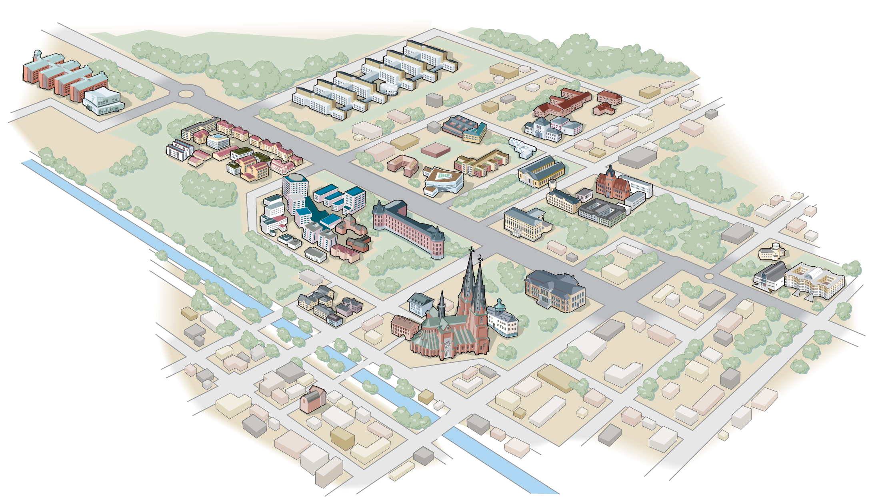
Uppsala
Notes:
Uppsala University is spread across a wide range of locations in Uppsala – quite literally – from the Ångström Laboratory in the south to Ekonomikum in the north.

Slide 15
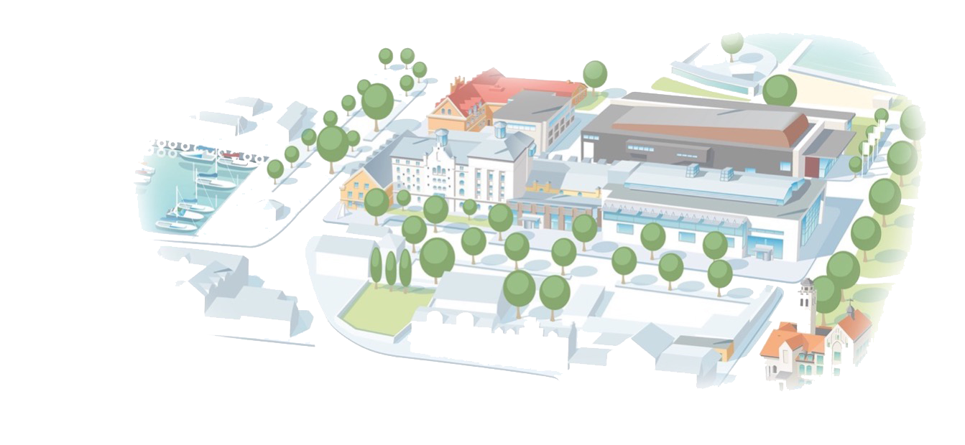
Campus Gotland
Notes:
Uppsala University’s Gotland Campus is situated in Visby and is more compact, just a stone’s throw from the harbour and right next to Almedalen.

Slide 16
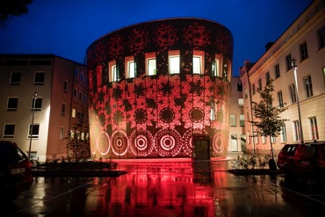
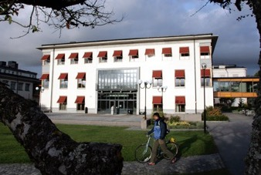
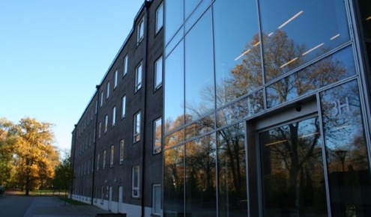
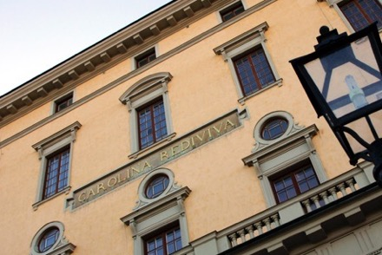
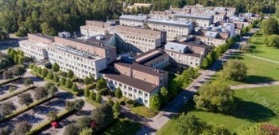
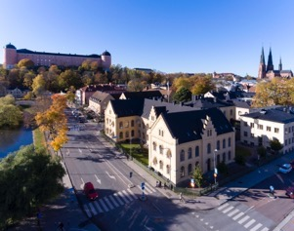
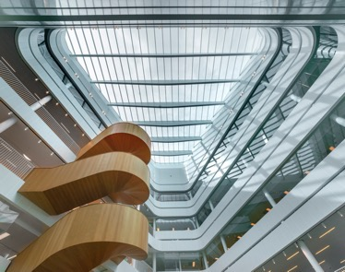
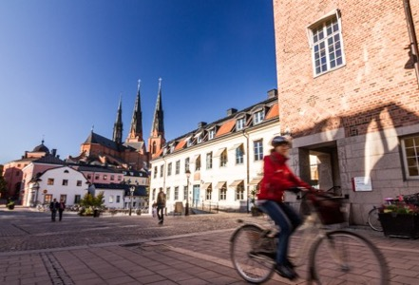
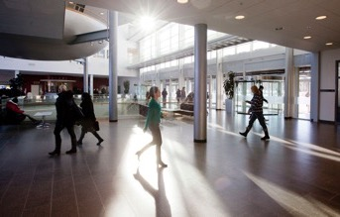
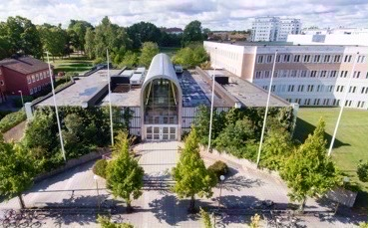
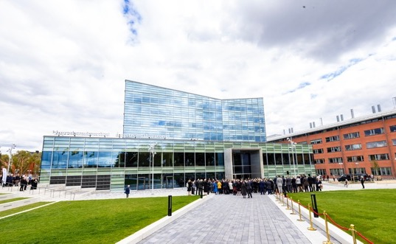

Slide 17
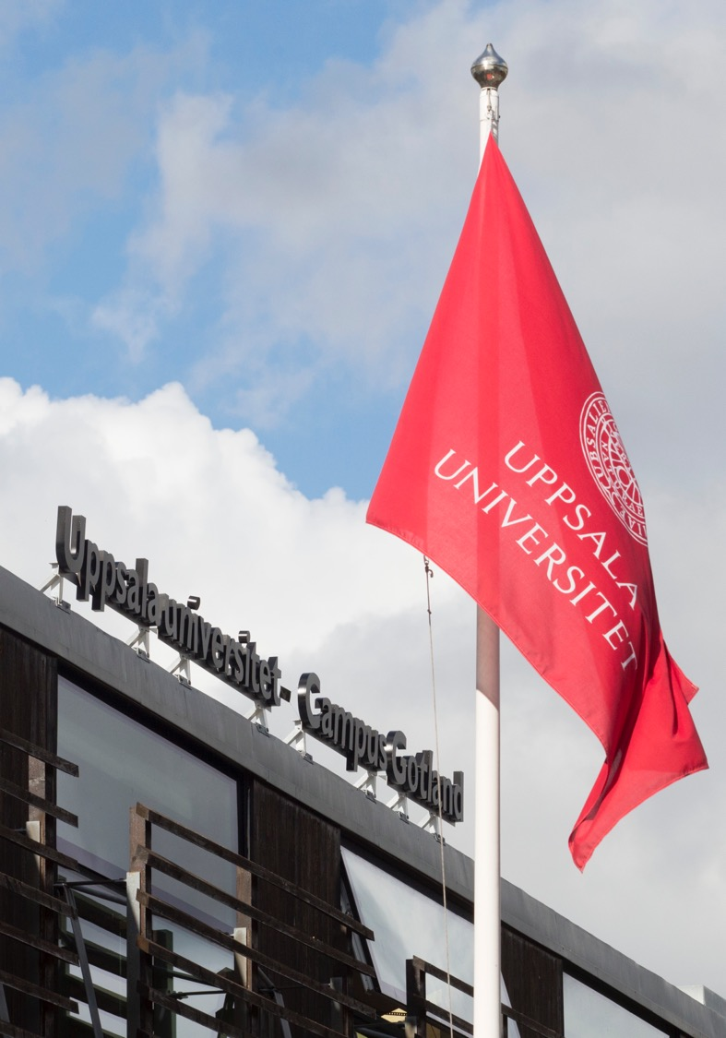

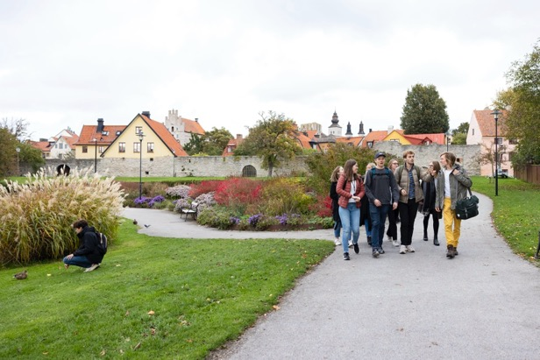
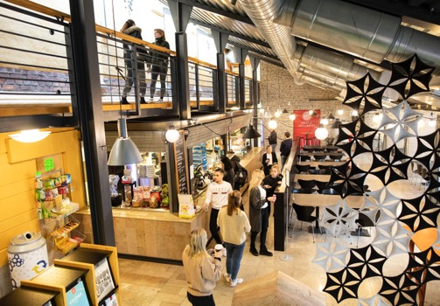
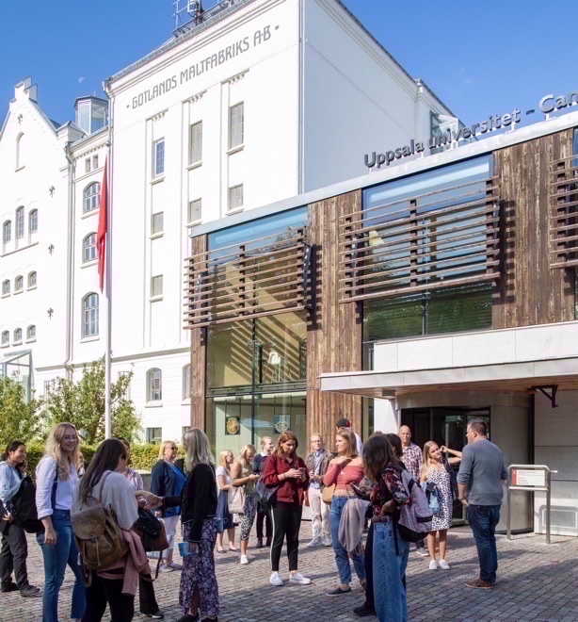


Slide 18
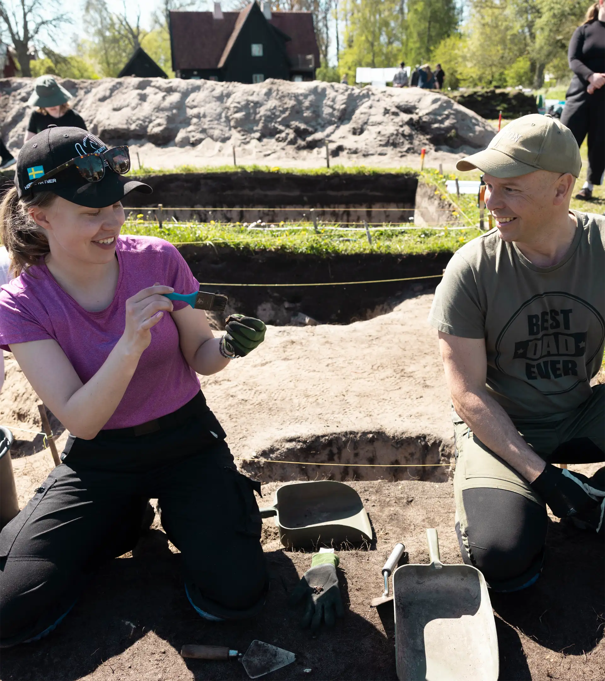
Education
Broad range of programmes.
Research-based.
Vibrant student life.
Notes:
Uppsala University offers courses across a wide range of subjects and in a variety of formats.
The breadth of the offering also makes it possible to combine different subjects and perspectives. Courses are offered across all the University’s scientific disciplines and at both undergraduate and postgraduate levels.
An important part of the University’s education is its link to research. Here, students engage with cutting-edge research and have the opportunity to develop a scientific approach – to seek, evaluate and apply knowledge independently.
In addition to the education itself, student life is an important part of the experience of studying in Uppsala. The University’s long history has given rise to traditions and environments that still characterise student life in the city.

Slide 19

Education by numbers
50,000 students
80 Bachelor’s programmes
100 Master’s programmes
1,600 freestanding courses
7,000 degrees per year
Our most popular study programmes are law, business and economics, medicine.
Notes:
(Part 1 of 2. Numbers for Uppsala University’s international study programmes are in the next slide.)

Slide 20

Education by numbers (2)
80 international Master’s programmes
8 international Bachelor’s programmes
660 freestanding courses in English
1,500 incoming exchange students of which 900 EU/Erasmus
1,100 outgoing
2,100 fee-paying students
Notes:
Numbers for our international study programmes and exchanges.
(Fee-paying students = International, non-EU students)

Slide 21
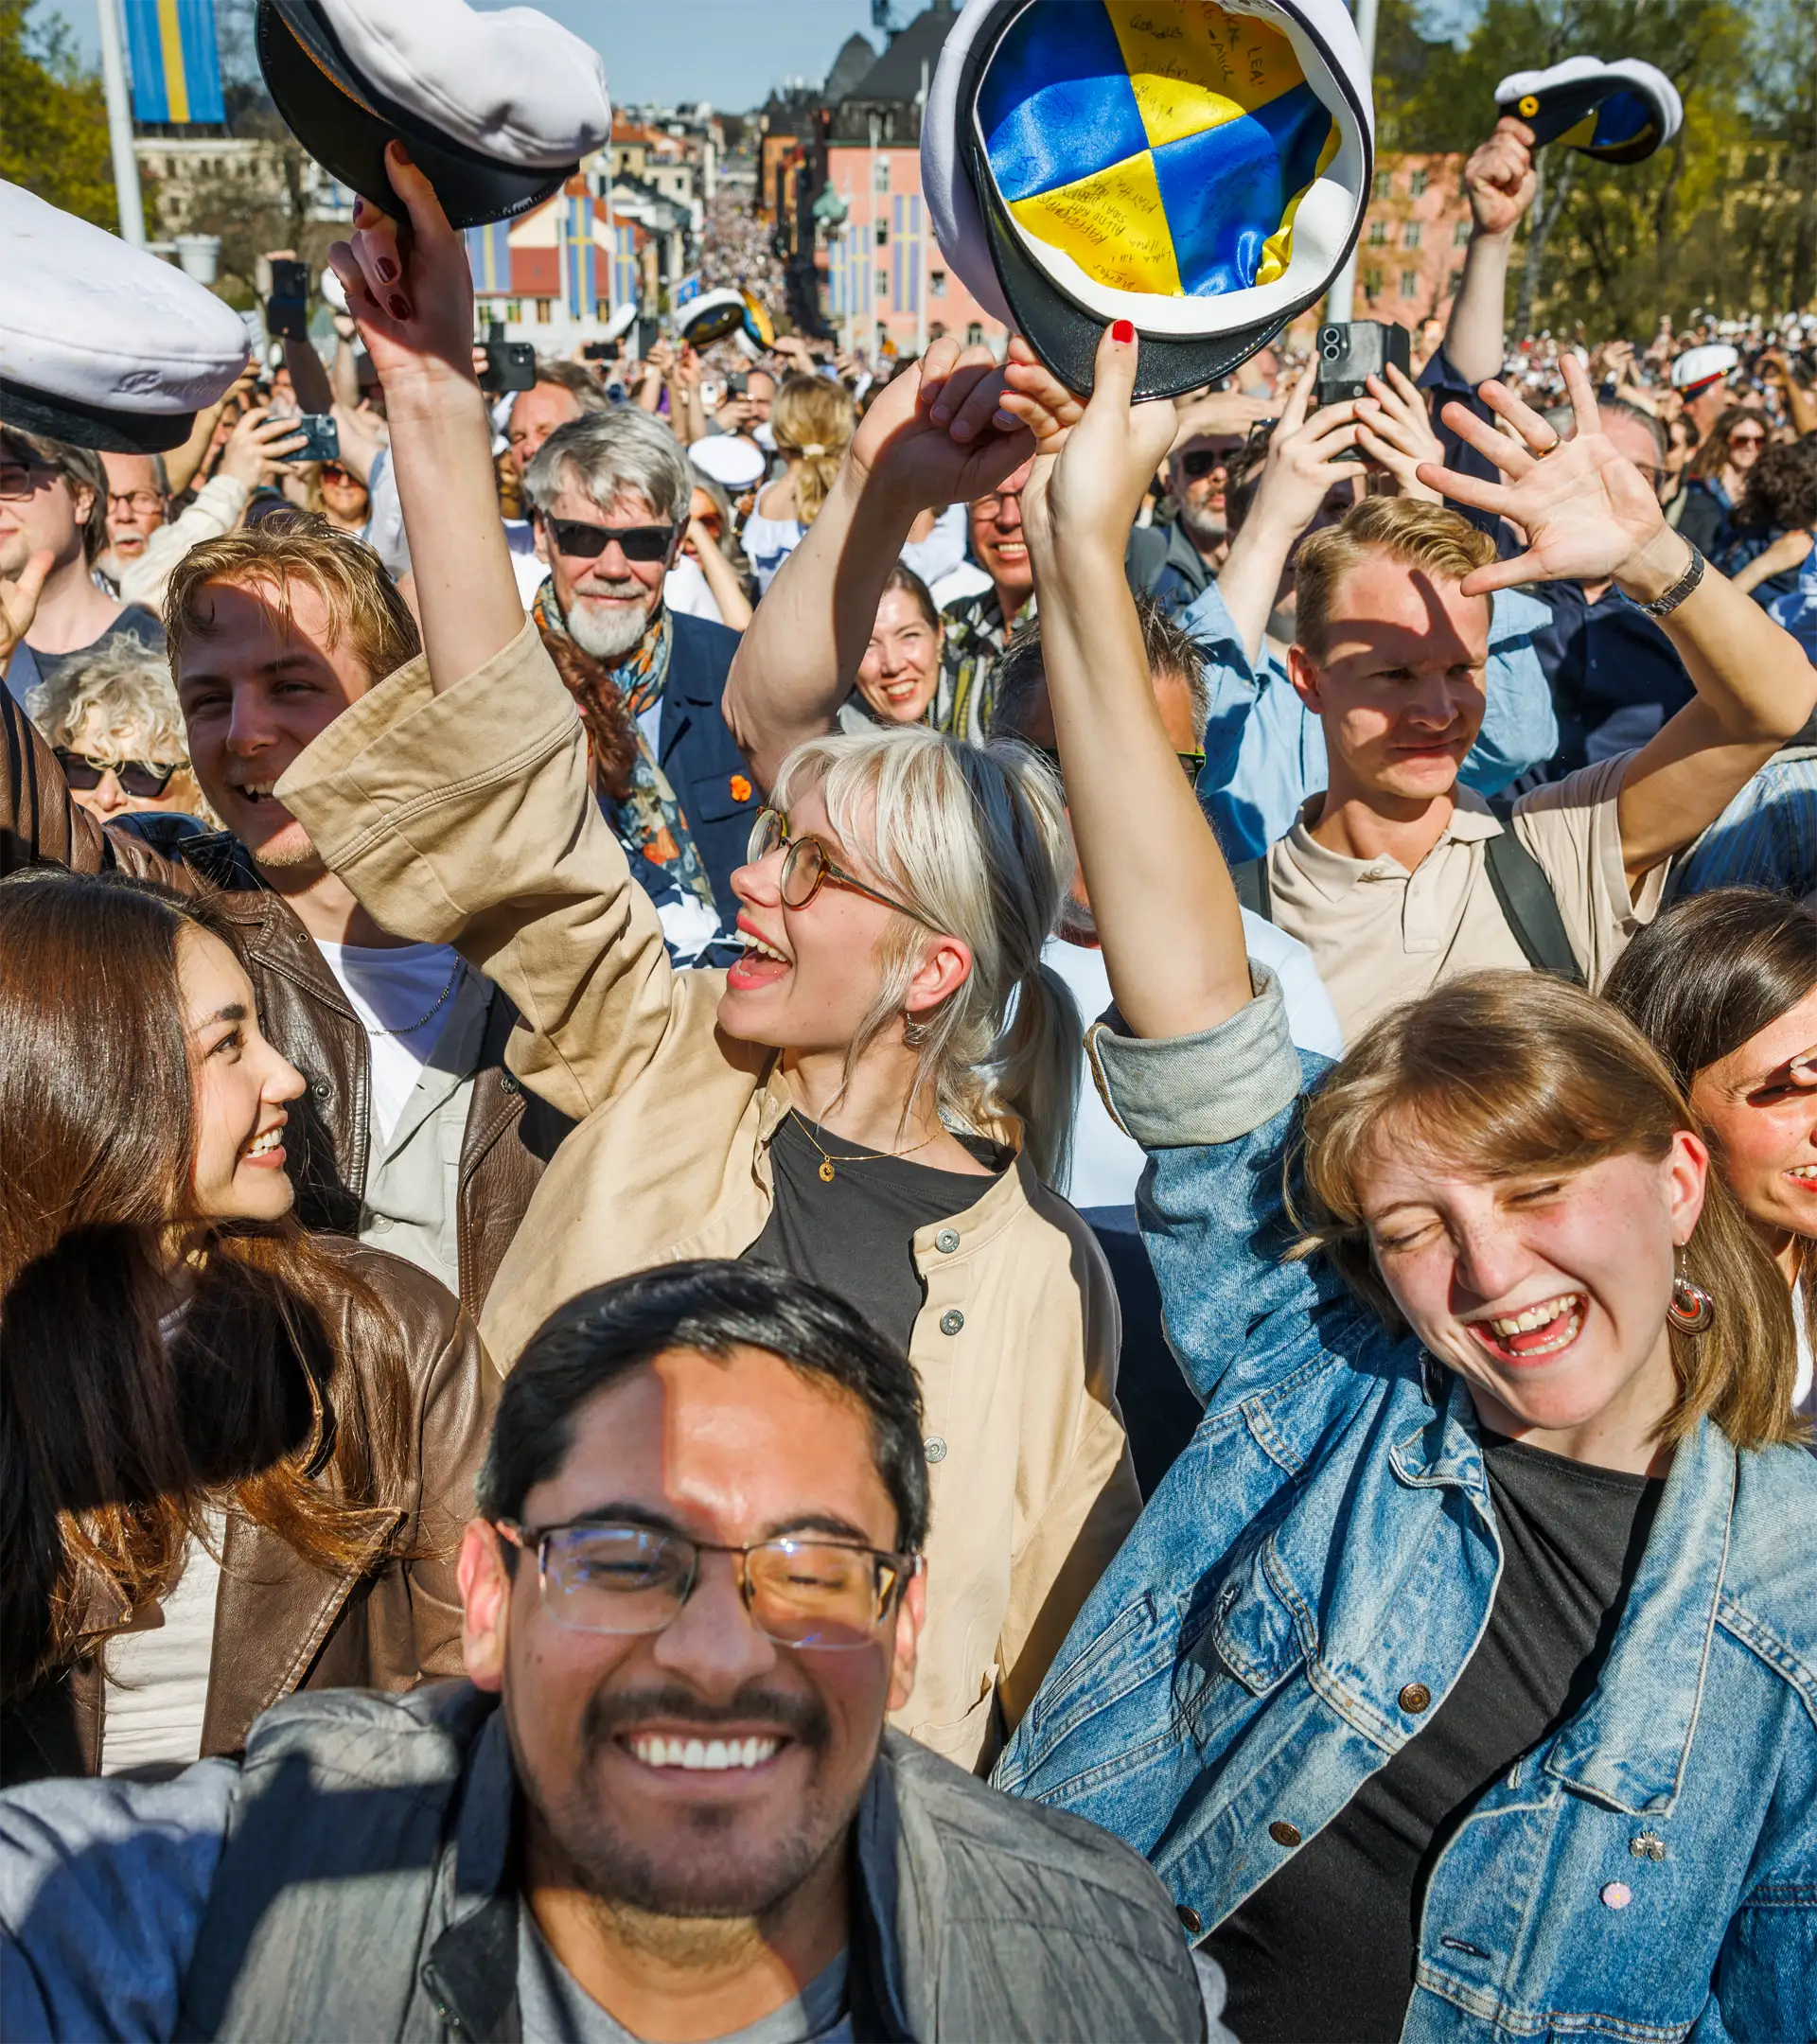
Student life and student participation
Student nations and unions.
Active student participation.
Living traditions.
Notes:
One of the reasons why many students choose Uppsala University is its vibrant student life and traditions. The 13 student nations are key meeting places for students and offer, amongst other things, social activities, cultural events, restaurants and pubs, as well as various forms of student association life.
Students are also organised through six student unions, which represent students’ interests in matters relating to education and the study environment.
Student involvement is an important part of university life. Students participate at various levels in the University’s work and can influence matters relating to the quality of education and students’ conditions.
Uppsala has many student traditions, many of which date back a long way in history. The best known is probably the ‘Sista april’ celebrations, featuring the Donning of the Caps at the University Library.

Slide 22
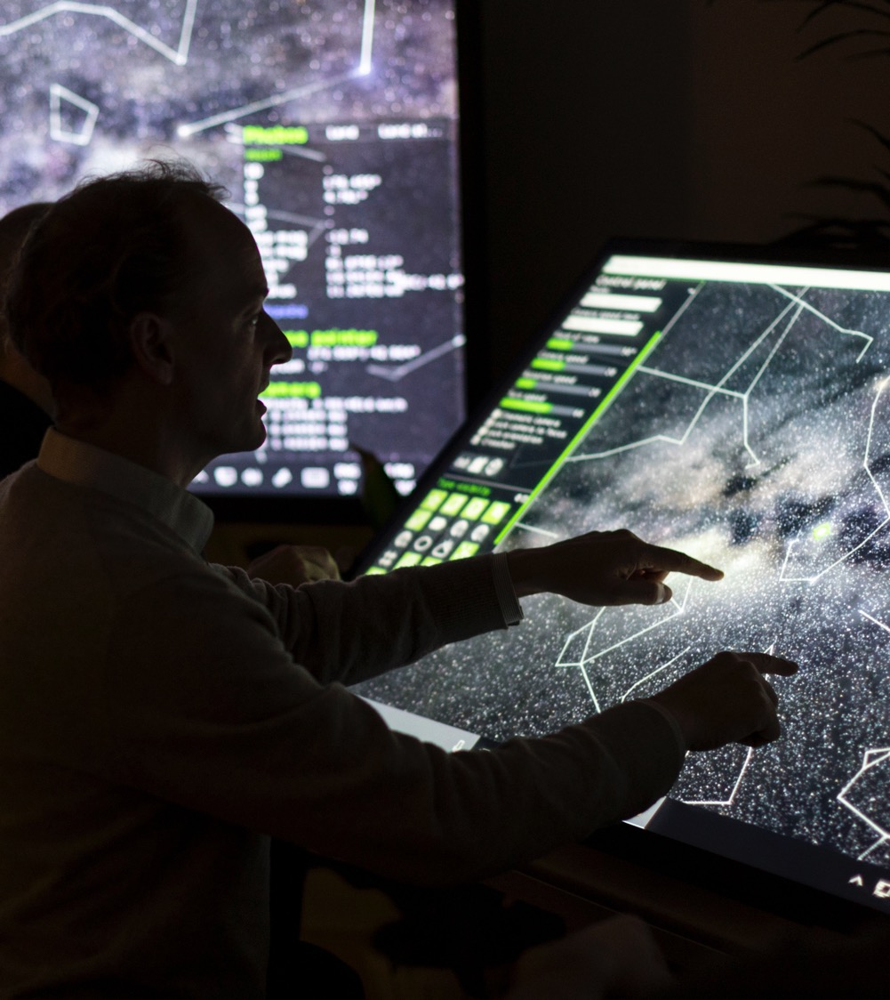
Research
Strong individual disciplines.
Interdisciplinary.
Internationalisation.
Collaboration.
Notes:
Uppsala University conducts research across a wide range of scientific fields, with strong research environments within all three of the University’s disciplinary domains.
Many of the questions that research seeks to address transcend traditional disciplinary boundaries. Having outstanding research in so many fields within a single university provides unique opportunities for interdisciplinary collaboration.
The research is also highly international. Collaboration with researchers in other countries and continents is crucial if our research environments are to become – or remain – world-leading. Our strong research environments also attract researchers from all over the world to come here and become part of Uppsala University.
Another important aspect is engagement with the wider community. Through collaborations with, for example, the business sector, organisations and the public sector, research findings can have an impact beyond the university.
The next slide provides examples of some of the major research challenges that researchers at Uppsala University are working on.

Slide 23
We are taking on the research challenges of the future
Antibiotic resistance
Artificial intelligence
Biodiversity
Children’s right to development
Climate change
Democracy
The development of life
Digital humanities
Drug development
Energy
Global health
Human rights
Life sciences
Medical technology
Mental health
Migration and racism
New materials
Peace and social security
Public health diseases
Social sustainability
Space research and space technology

Slide 24

Research and doctoral programmes by numbers
150 doctoral subject areas
2,400 doctoral students
380 doctoral degrees per year
5,900 scholarly publications
SEK 6,500 million turnover in research and doctoral education
58% of research funding from external sources

Slide 25
International cooperation
Networks where Uppsala University is a member:
The Guild
Coimbra
Matariki
Europauniversitetet Enlight
The Baltic University Program
South Africa-Sweden University Forum (SASUF)
ACCESS
MIRAI 2.0.
Notes:
International cooperation is a means and a strategy for achieving higher quality research and education.
Uppsala University works with this in different ways, including being part of several networks, projects, and regional centres with other universities around the world.

Slide 26
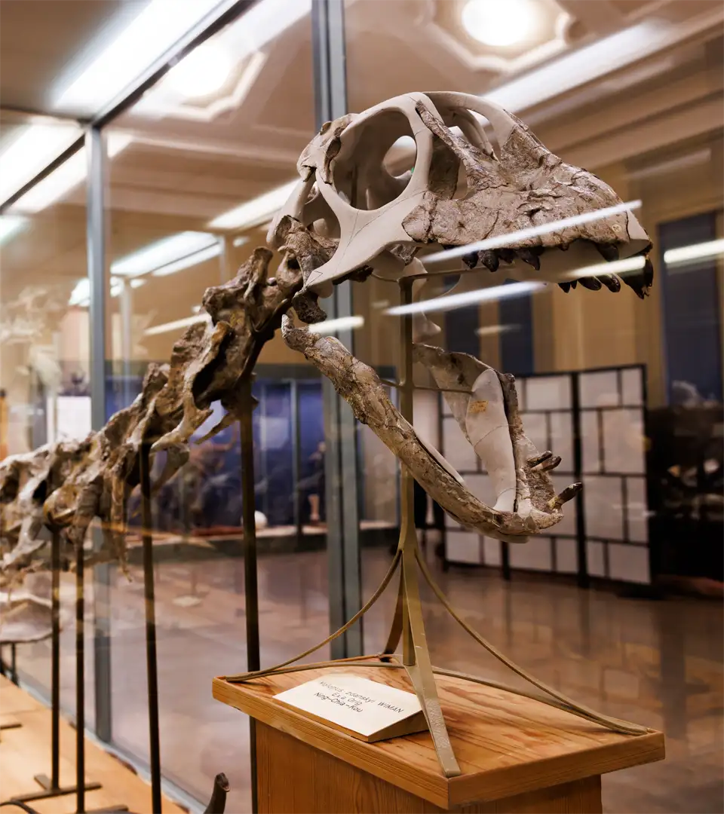
Living cultural heritage
Museums – gardens – music
Notes:
Uppsala University has unique collections and rich cultural offerings.
Museums: Museum of Evolution, Gustavianum, Museum of Medical History,
Uppsala University Library
Gardens: The Linnaeus Garden and the Botanical Garden are Sweden’s oldest botanical gardens. 9,000 species from all over the world are grown here. The Linnaean gardens also include Linnaeus’ Hammarby – the small estate that Linnaeus bought in 1758 to get away from Uppsala in the summers.
Music: Royal Academic Orchestra, Uppsala University Jazz Orchestra, student nation choirs, student orchestras
In the following pictures, we’ll see more examples of the beautiful cultural environments found at Uppsala University.

Slide 27

Notes:
The Book Hall at Carolina Rediviva – the University Library.

Slide 28

Notes:
The art exhibition at Gustavianum, Uppsala University Museum.

Slide 29

Notes:
The magnificently decorated ceiling of the Grand Auditorium.

Slide 30
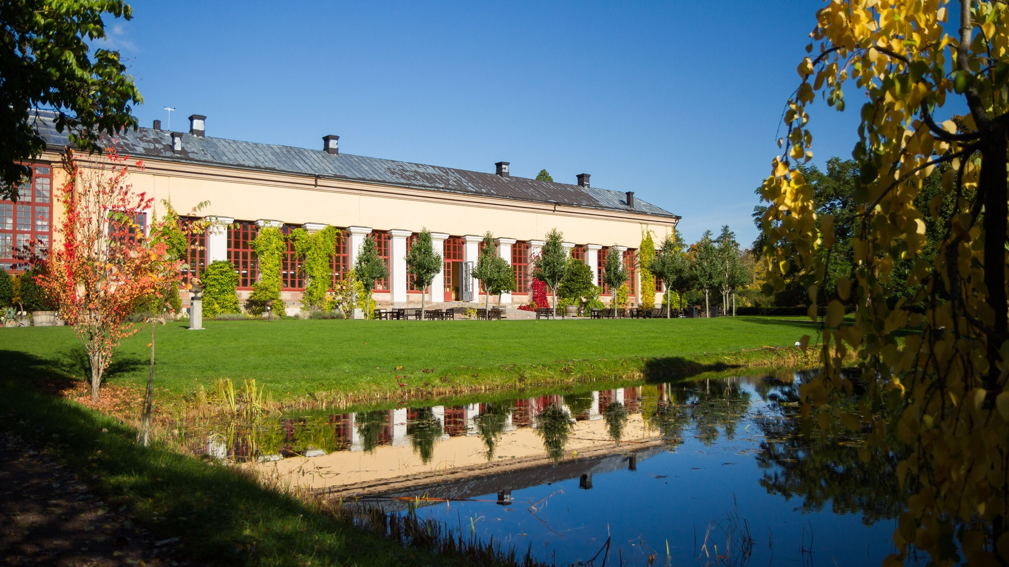
Notes:
The Orangery of the Botanical Gardens.

Slide 31
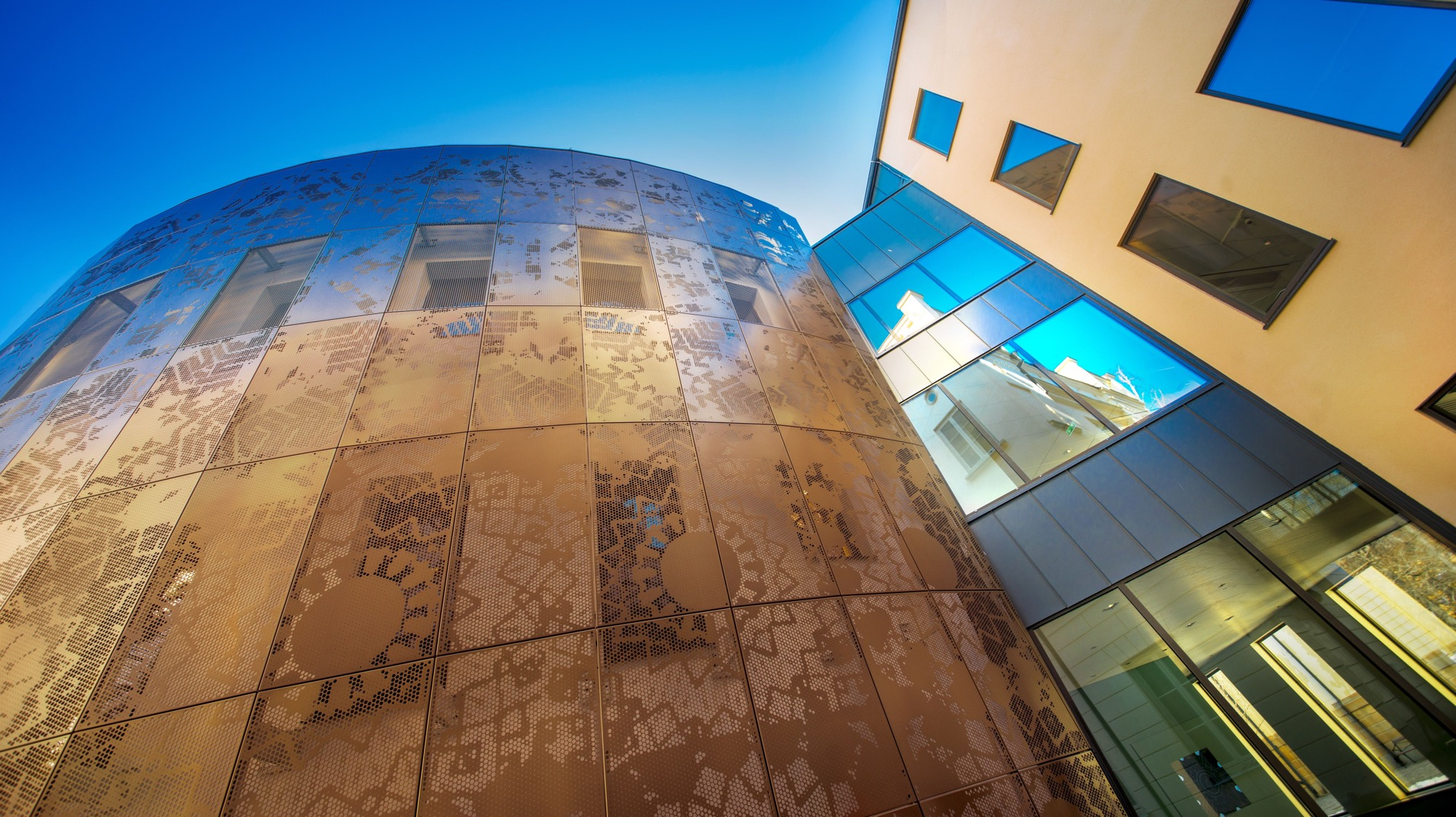
Notes:
The Humanities Theatre.

Slide 32
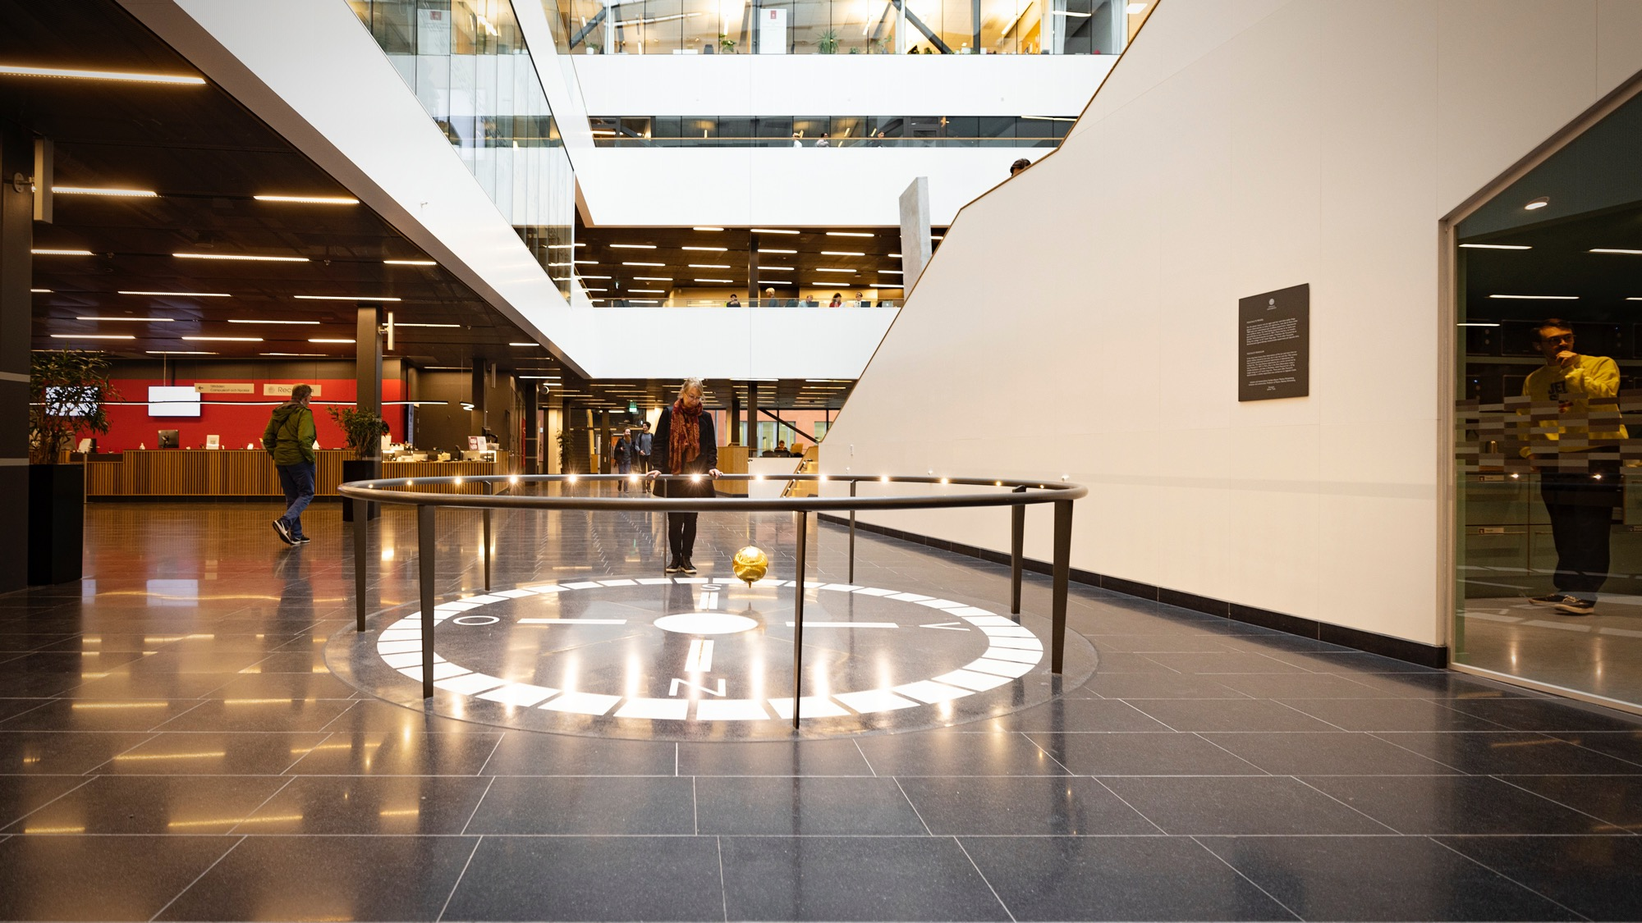
Notes:
The Focault pendulum in the entrance hall of the Ångström Laboratory.

Slide 33
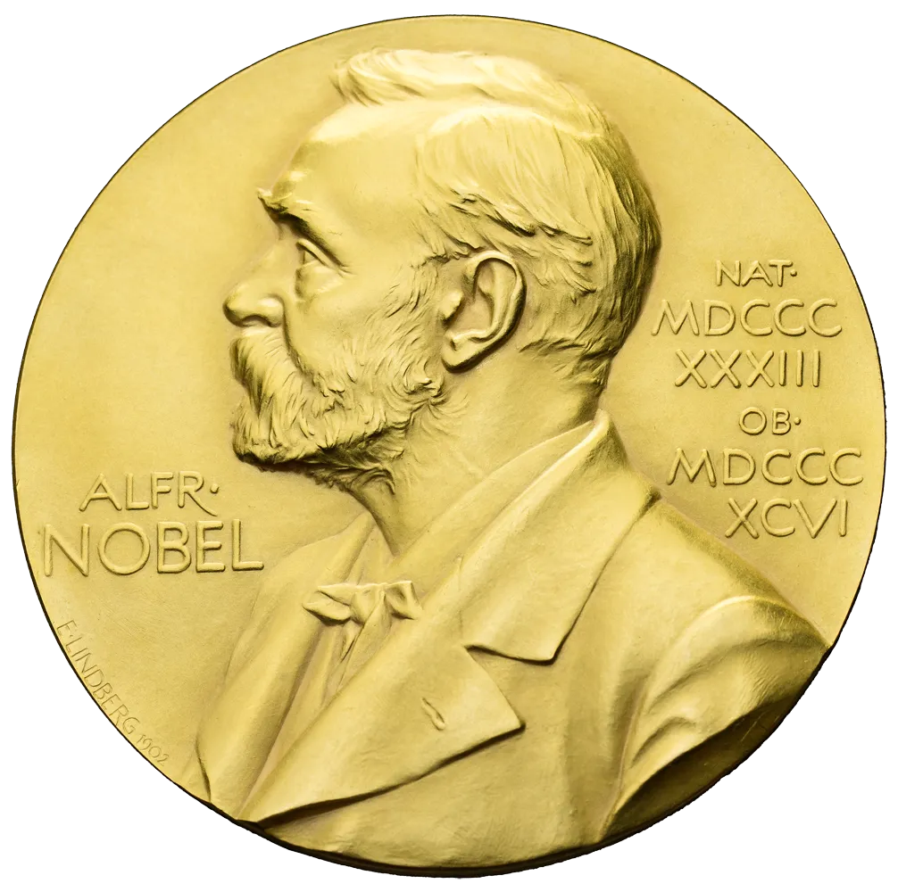
Nobel Laureates
Svante Pääbo – Physiology or Medicine 2022
Kai Siegbahn – Physics 1981
Dag Hammarskjöld – Peace 1961
Arne Tiselius – Chemistry 1948
Nathan Söderblom – Peace 1930
Theodor (The) Svedberg – Chemistry 1926
Manne Siegbahn – Physics 1924
Allvar Gullstrand – Physiology or Medicine 1911
Notes:
Among the University’s alumni there are no fewer than 16 Nobel Prize laureates, of which the following 8 received their prizes for discoveries made during their time at Uppsala University.
It has long been the tradition for the newly awarded Nobel Laureates to be invited to Uppsala University each year in connection with the Nobel banquet in december.
The visit programme includes a reception with the Vice-Chancellor and lunch at Uppsala Castle, as well as appreciated and highly popular public lectures by the visiting Nobel Laureates.

Slide 34
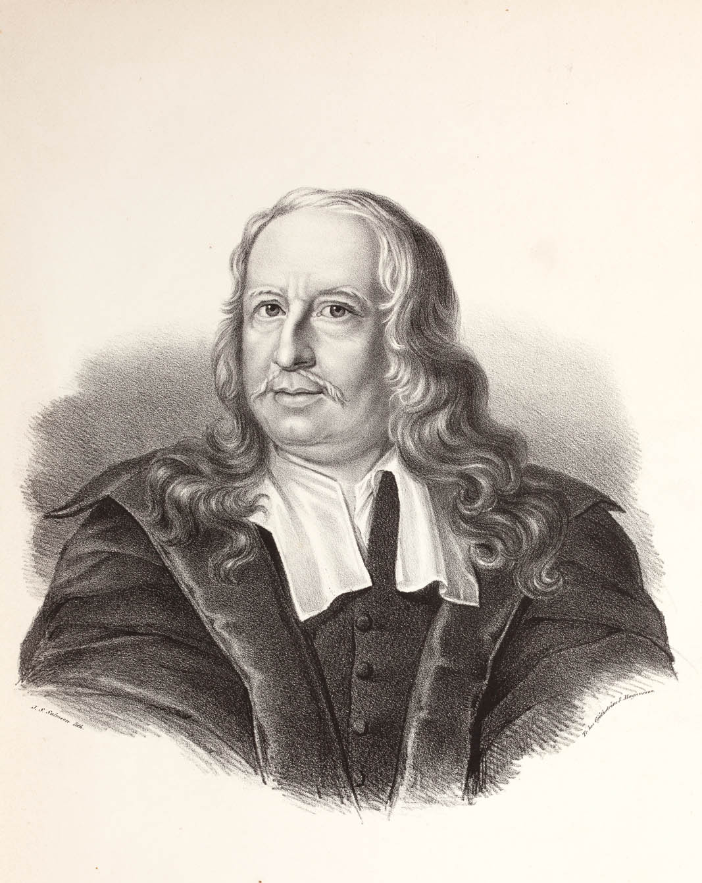
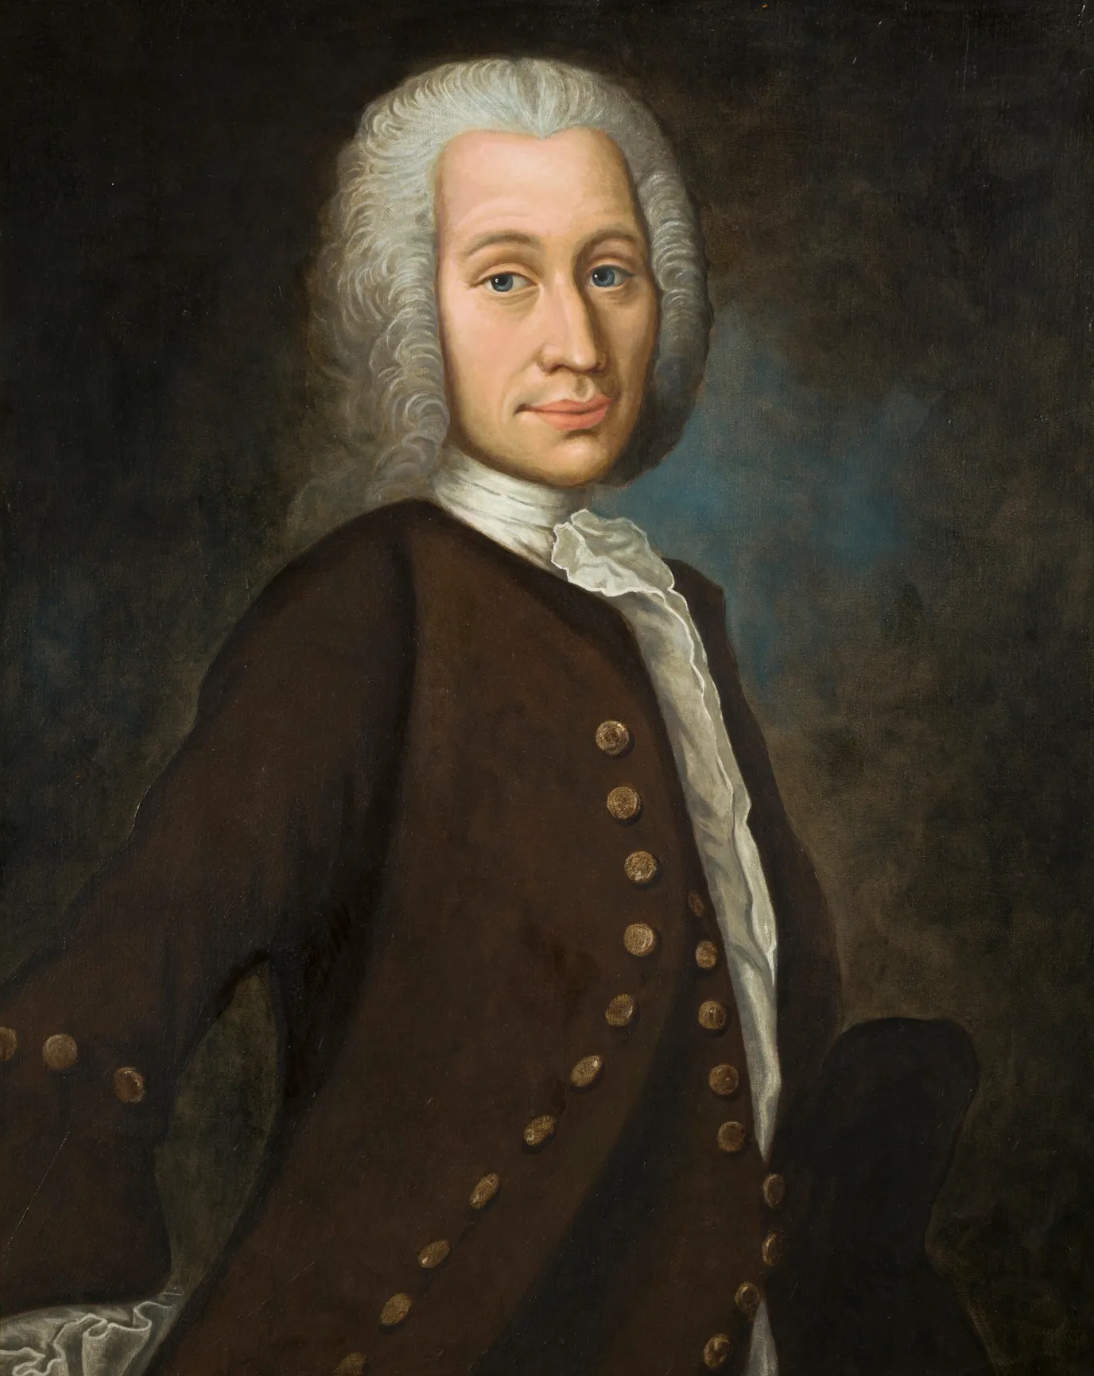
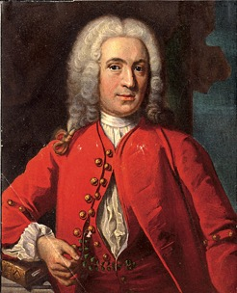
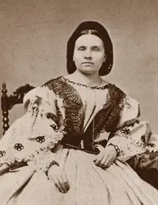
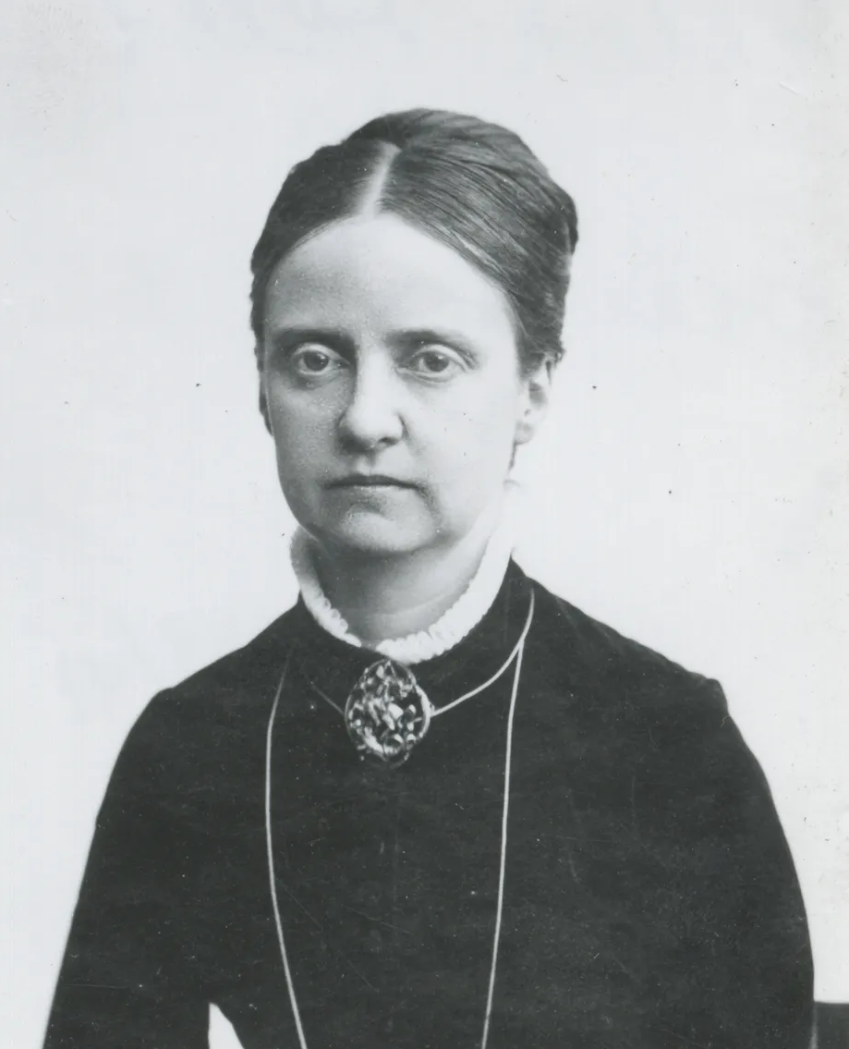
Some famous figures in Uppsala’s history
Olof Rudbeck
1630–1702
Anders Celsius
1701–1744
Carl Linnaeus
1707–1778
Betty Pettersson
1838–1885
Ellen Fries
1855–1900
Notes:
Olof Rudbeck discovered the body’s lymphatic system, which has been described as the first scientific discovery made by a Swede.
Anders Celsius is best known for defining a new temperature scale that was more accurate than previous scales. He commissioned the construction of Uppsala’s first astronomical observatory and calculated that there must be a connection between the Northern Lights and the Earth’s magnetic field.
Carl von Linné classified animals, plants and minerals and established the modern scientific naming system for species using two-part Latin names.
Betty Pettersson was Uppsala University’s – and Sweden’s – first female student. After graduating, she went on to become Sweden’s first female teacher at a state school.
Ellen Fries was a pioneer in Swedish women’s history research and became the first woman to be awarded a doctorate at a Nordic university.

Slide 35
Organisation
University Board
Electorial College
Internal Audit
Vice-Chancellor
UUniFI
University Administration
University Library
Disciplinary Domain
of Humanities
and Social Sciences
Disciplinary Domain
of Medicine
and Pharmacy
Disciplinary Domain
of Science
and Technology
Faculties
Theology
Law
Arts
Languages
Social Sciences
Educational Sciences
Faculties
Medicine
Pharmacy
Faculty
Science
and Technology
Departments
Departments
Departments

